Slide 1
Anaplan
Go-to-market Planning Applications
Territory and Quota Planning
Technical Overview
Application Version 2.1.0
Last updated June 2, 2025

Slide 2
Confidentiality notice
This documentation and any related materials are provided solely for the use of authorized Anaplan customers who have purchased the Territory and Quota Planning Application and are considered Anaplan proprietary information. The information contained herein is intended exclusively for the purpose of implementing the application by authorized customers. Any use outside of this intended purpose is strictly prohibited, including but not limited to:
  Sharing, distributing, or disclosing this content with or to individuals or entities not directly involved in the customer’s authorized implementation.
  Using the documentation, in whole or in part, to replicate, retrofit, or reverse-engineer the functionality in other models, environments, or platforms.
This documentation contains proprietary information of Anaplan and is protected by applicable intellectual property laws. Any unauthorized use, reproduction, or dissemination is a violation of these terms and may result in legal action.

Slide 3

Table of Contents
1
Application overview
2
Process & configurable elements
3
Prework & assumptions
4
Implementation model design

Slide 4
Application overview
Section 1

Slide 5
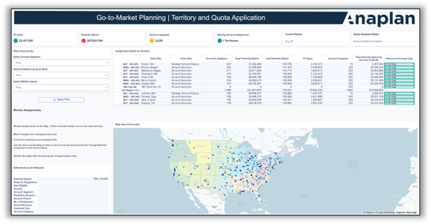
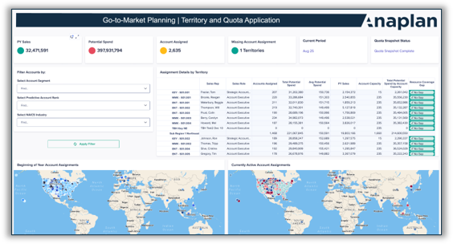
Territory and Quota Planning
Out-of-the-box functionalities to support territory design, rep alignment, target setting, and quota allocation
Scenario Planning
  Customize forecasts for dynamic planning.
  Model full-year projections and growth strategies.
  Build scenario plans by segment, product, or sales role.
  Create driver-based scenarios (e.g., new business vs. renewals).
  Compare multiple scenarios to evaluate outcomes.
Target Allocations:
  Input, adjust, and override sales targets (top-down/bottom-up).
  Lock targets dynamically with approval workflows.
  Conduct final reviews and adjustments against roll-up view.
Account-to-Territory Assignment:
  Optimized account to territory assignments.
  Assign multiple territories to reps.
  Model redistribution scenarios.
  Support zip-code planning with geo-mapping capabilities.
  Assign multiple territories to a single rep as needed.
  Model different scenarios for account redistribution.
Rep-to-Territory Assignment:
  Assign and update sales teams and overlays by role.
  Manage temporary assignments, start/end dates, and role transitions with effective dates to plan coverage.
  View and allocate unassigned reps for proper coverage.
  Create territory hierarchies based on sales team relationships.
  Increase flexibility by allowing reps to be assigned to multiple territories or assigned as player/coach roles.
Quota Assignment:
  Assign quotas directly to reps and overlays, or use role-based targets.
  Allocate quotas with ramping, seasonality, and flexible dimensions (e.g., hierarchy, role, product line).
  Compare top-down vs. bottom-up quota allocations.
  Approve and export finalized assignments.

Slide 6
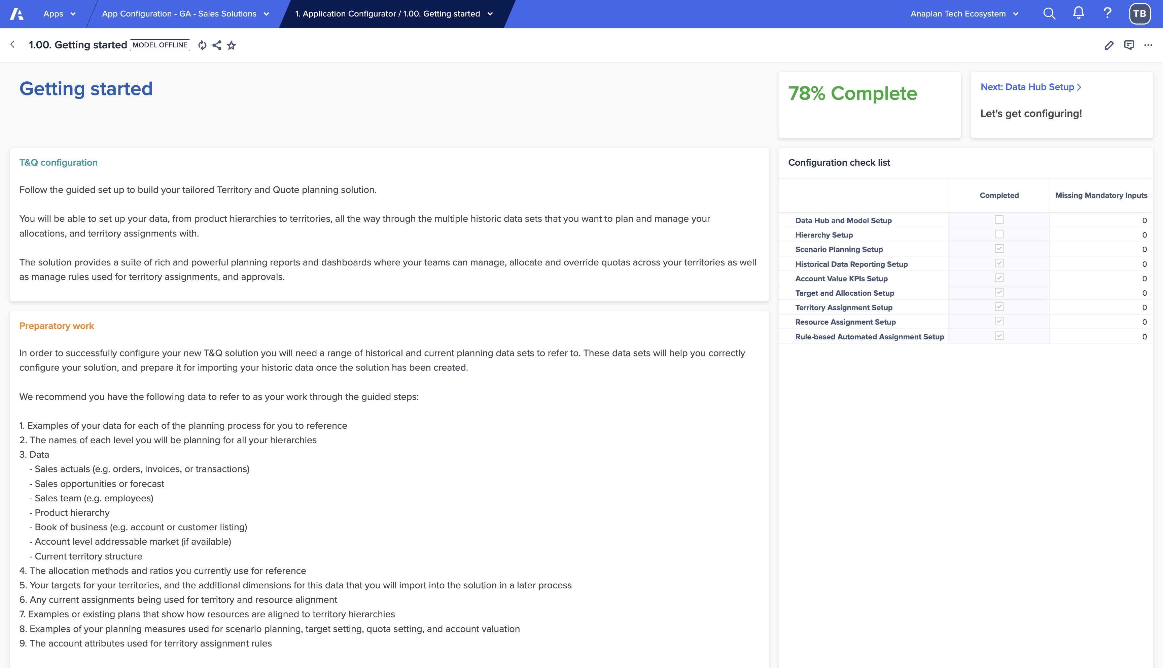
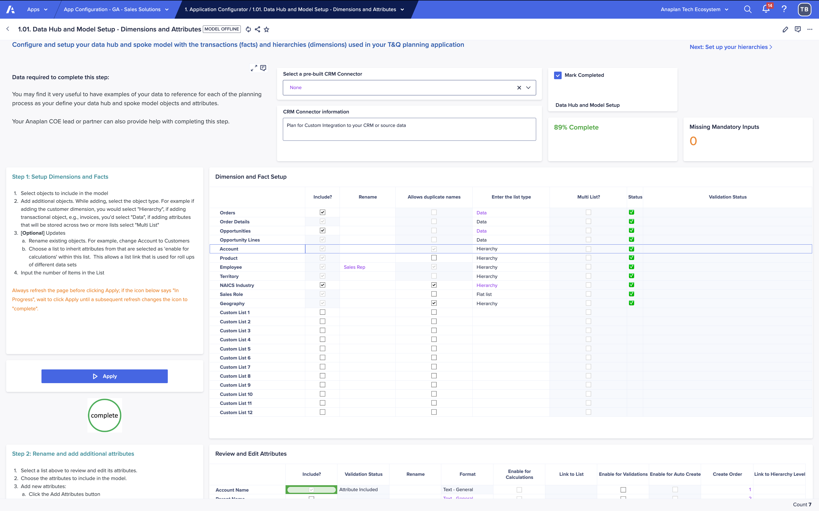
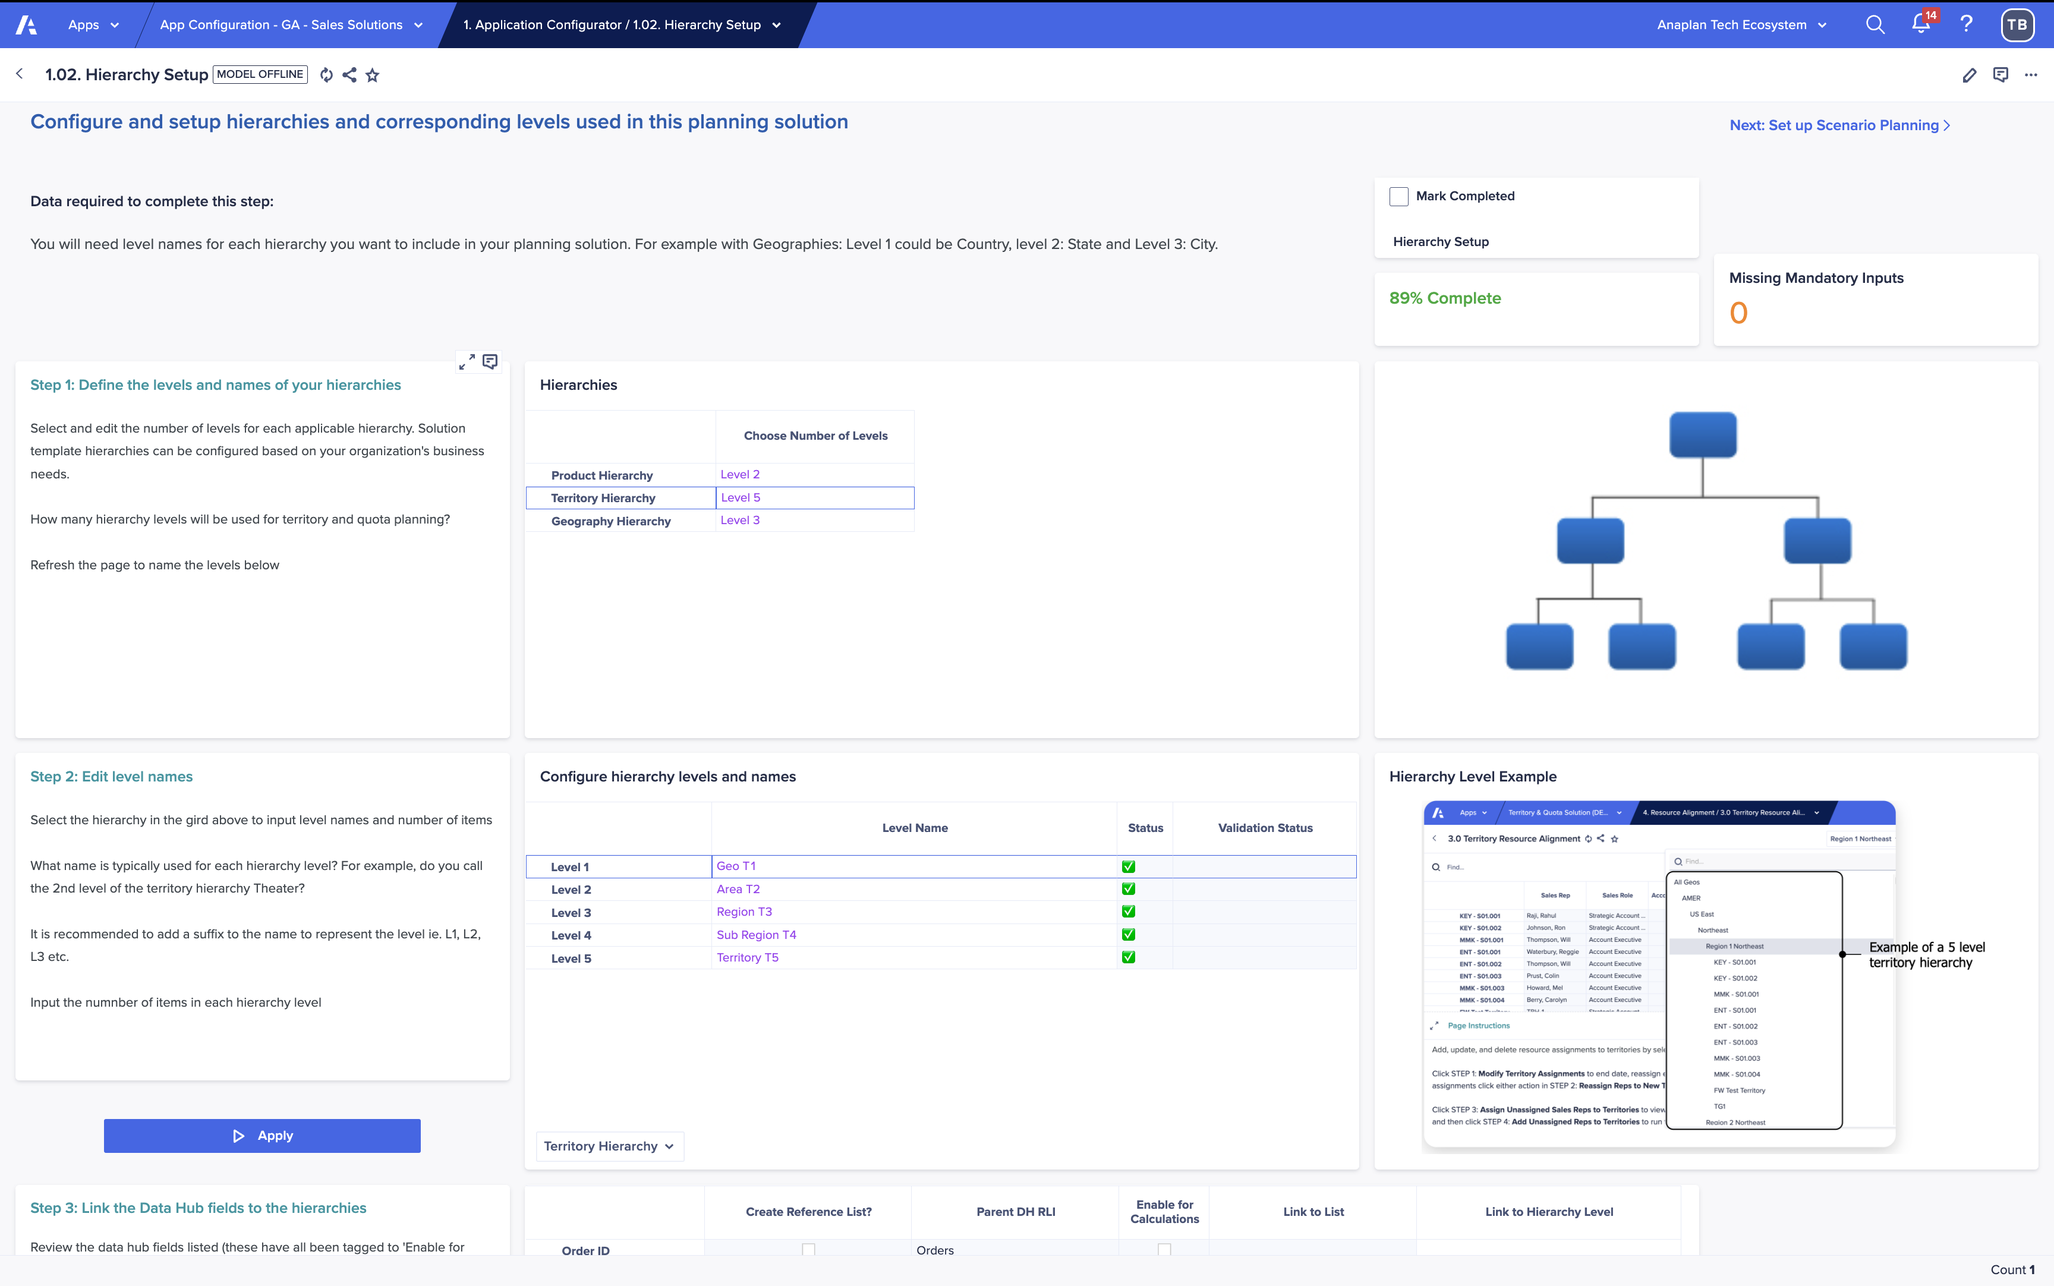
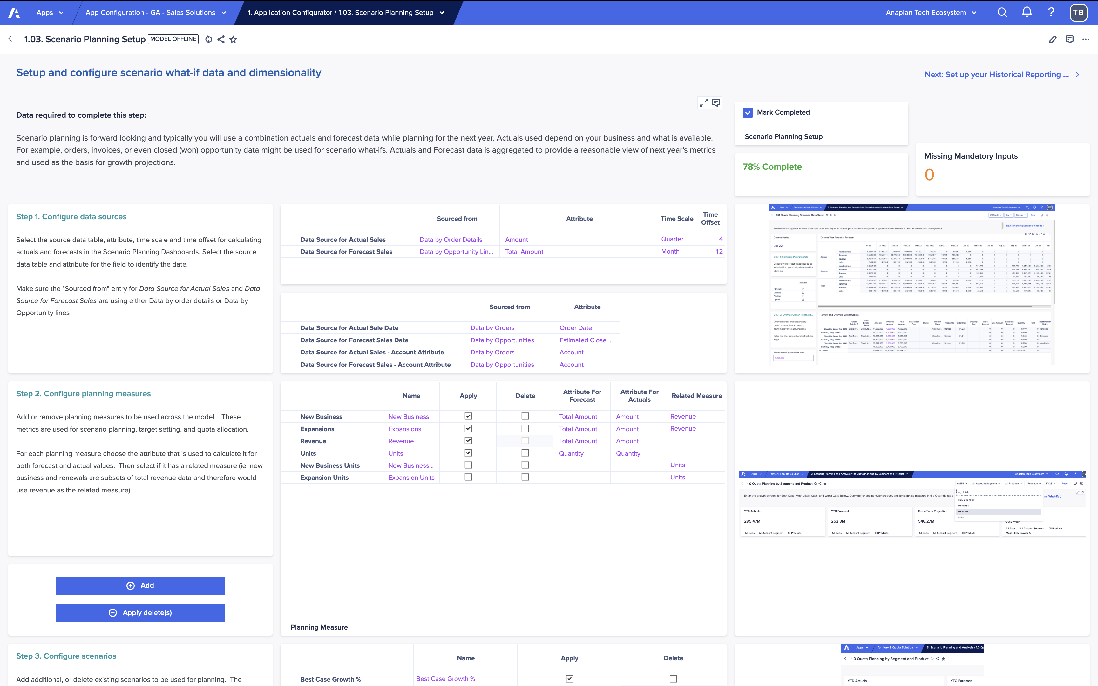
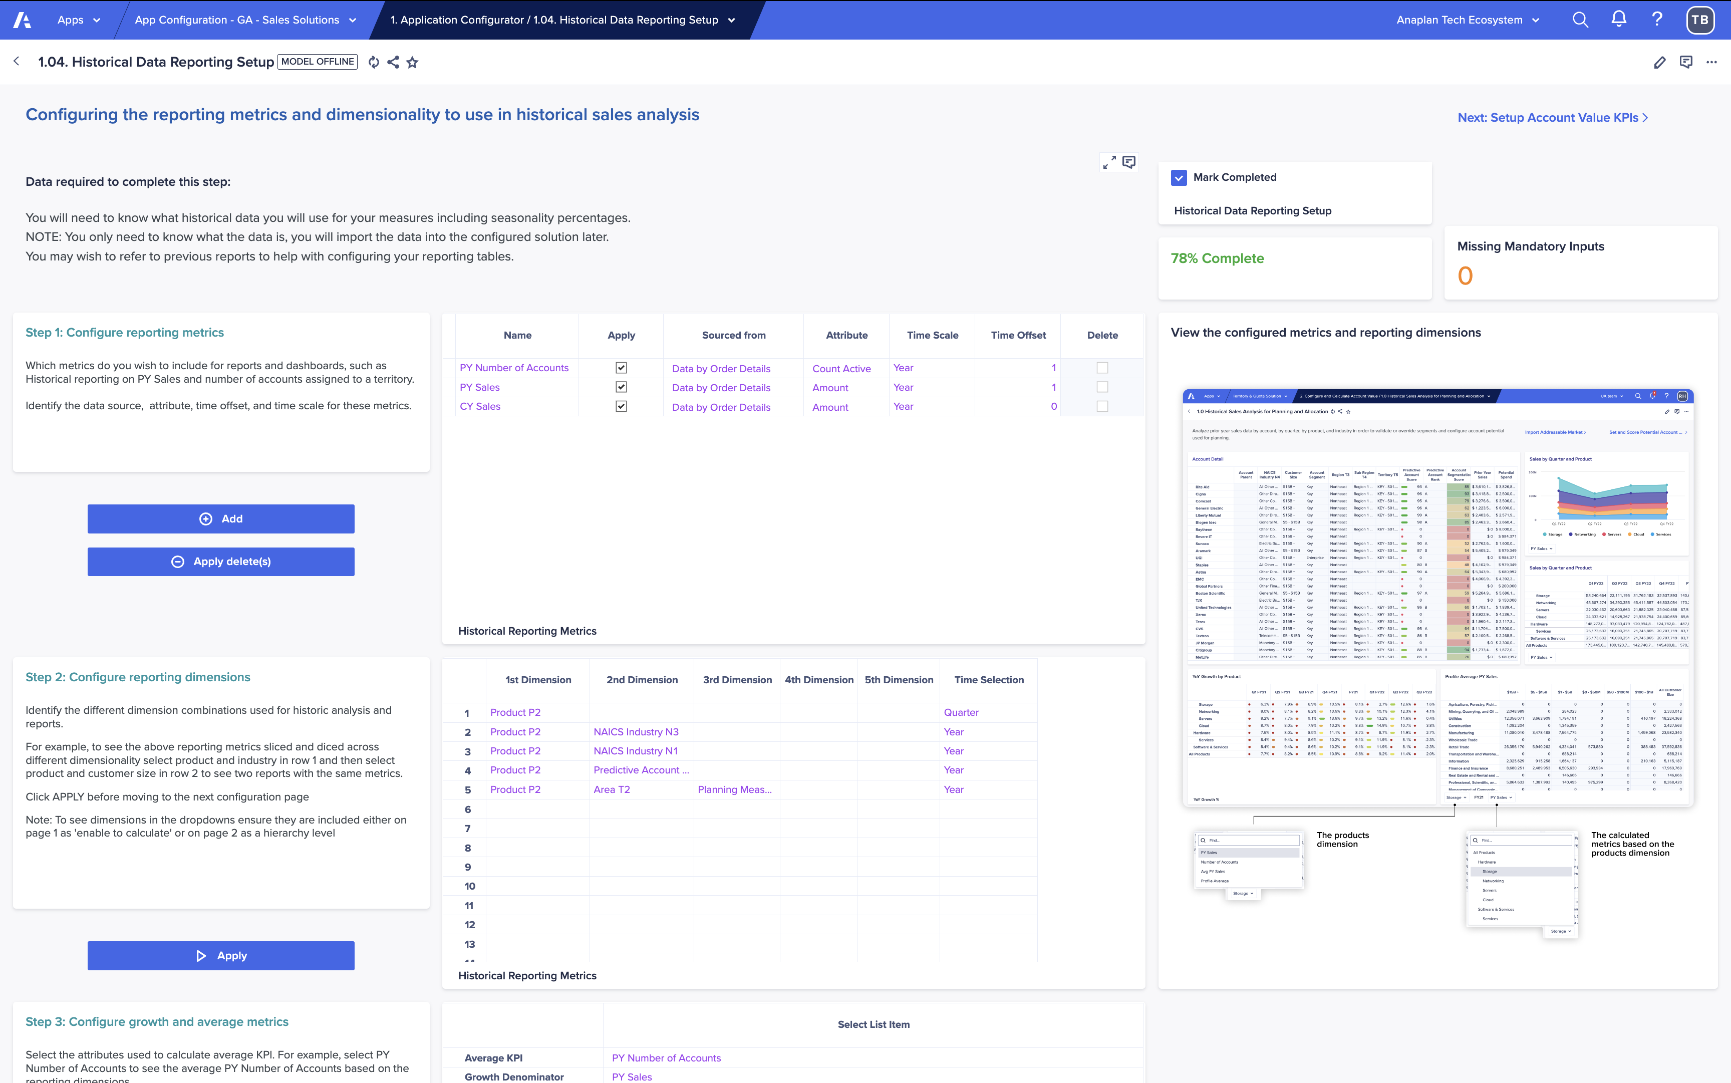

Guided setup powered by the Anaplan Application Framework
Designed to get you to value faster with a proven, repeatable configuration flow
Guided Setup
Quickly configure your application by answering structured questions about your business model, GTM structure, and planning needs. No blank canvas required.
1
2
3
4
Step-by-step
configuration
Deploy…
Data
Hierarchies
Resources
Assignments

Slide 7
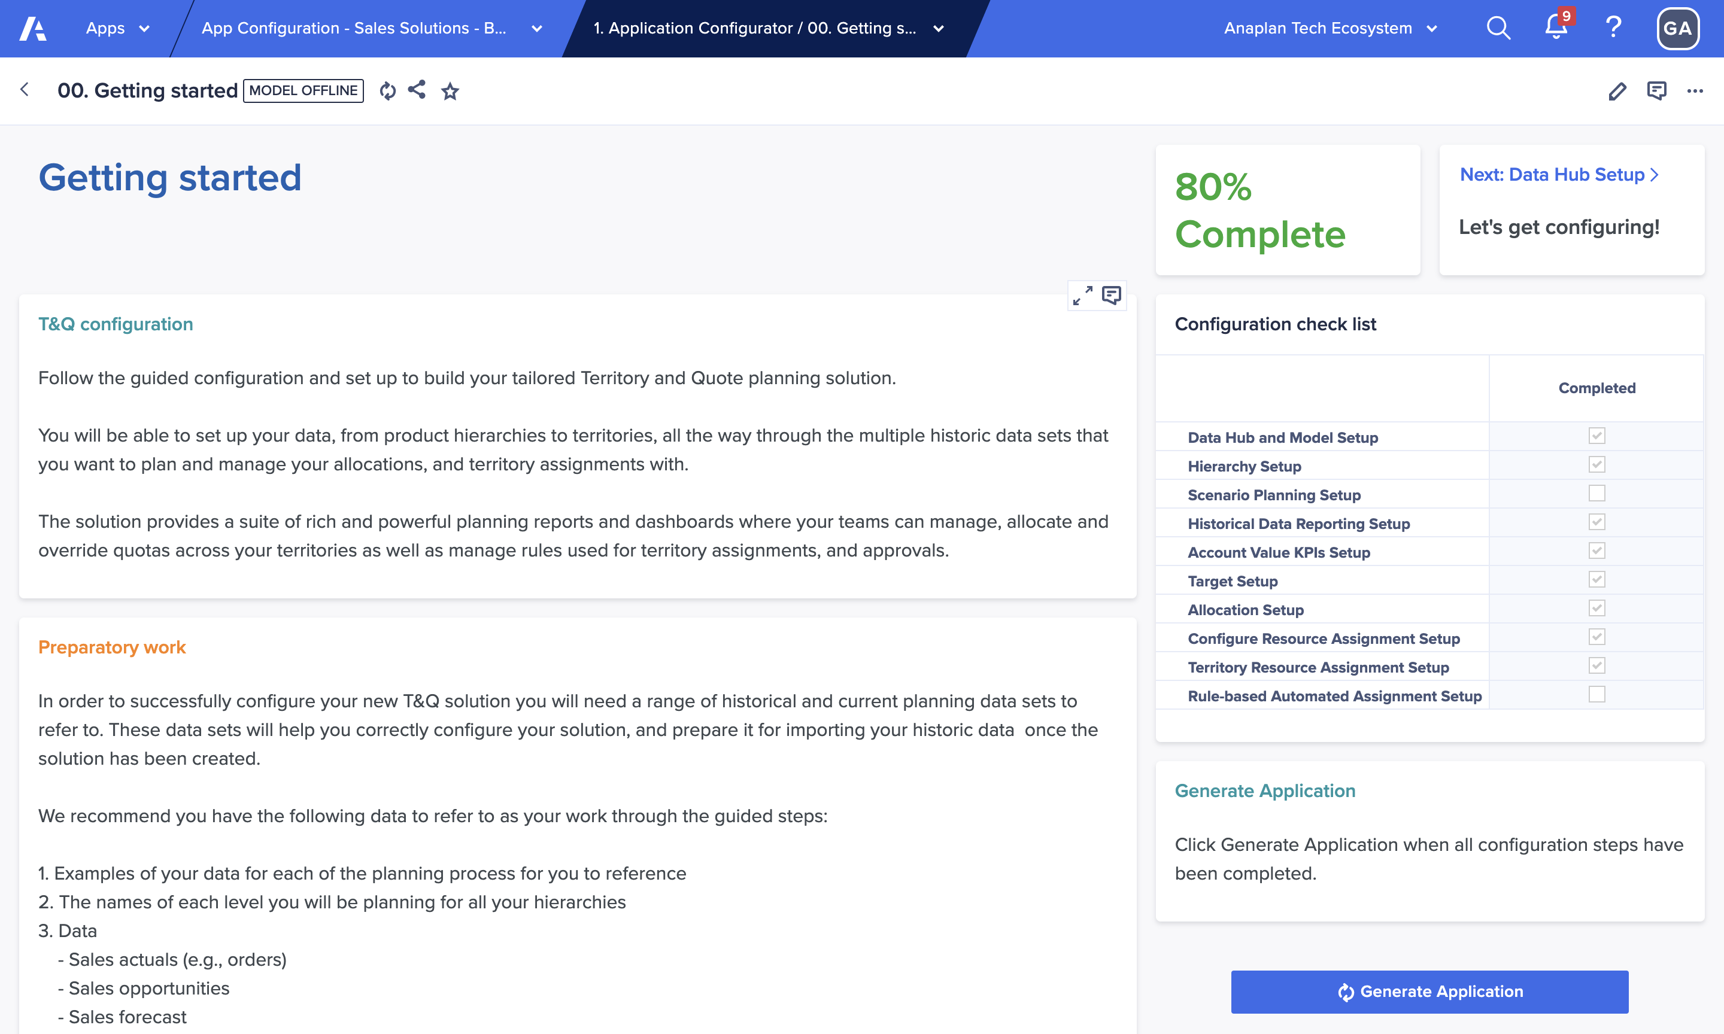
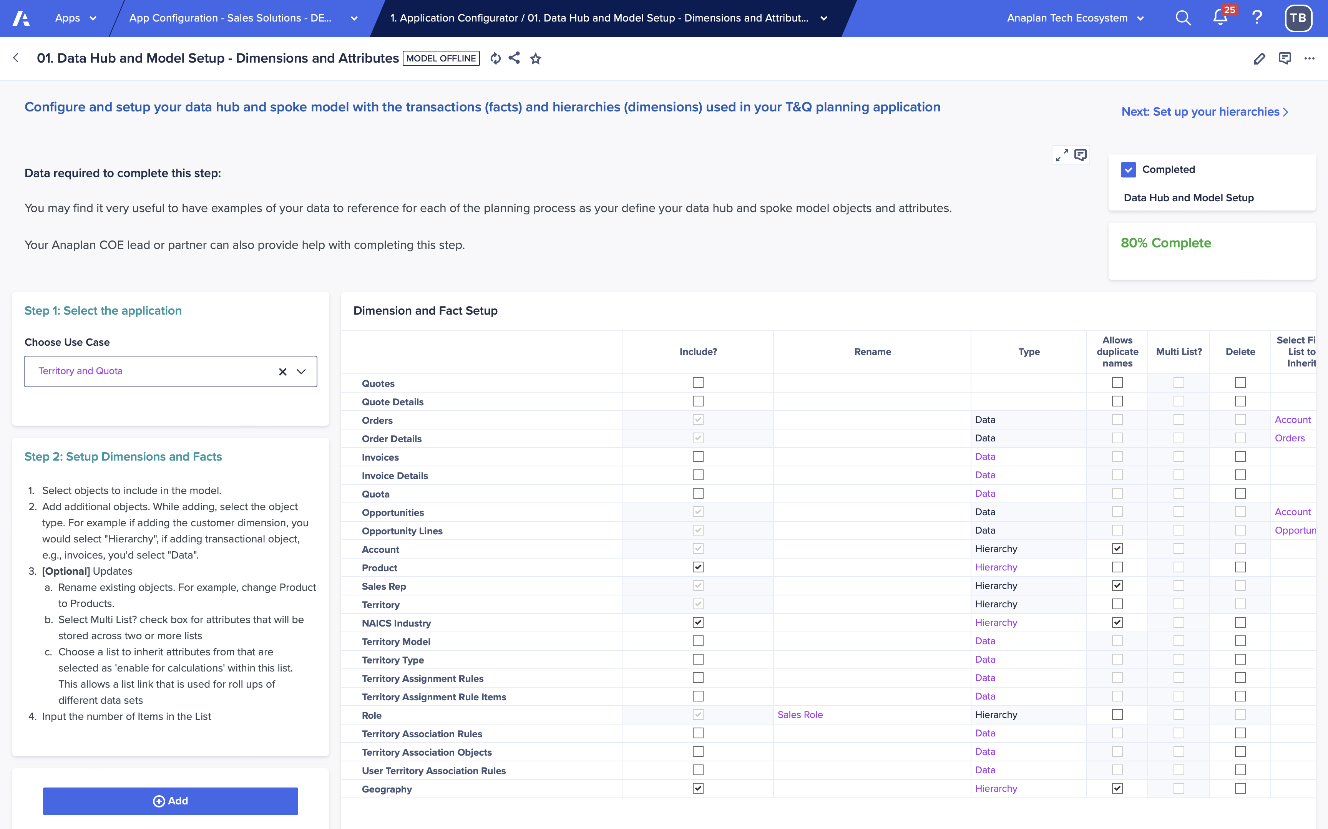
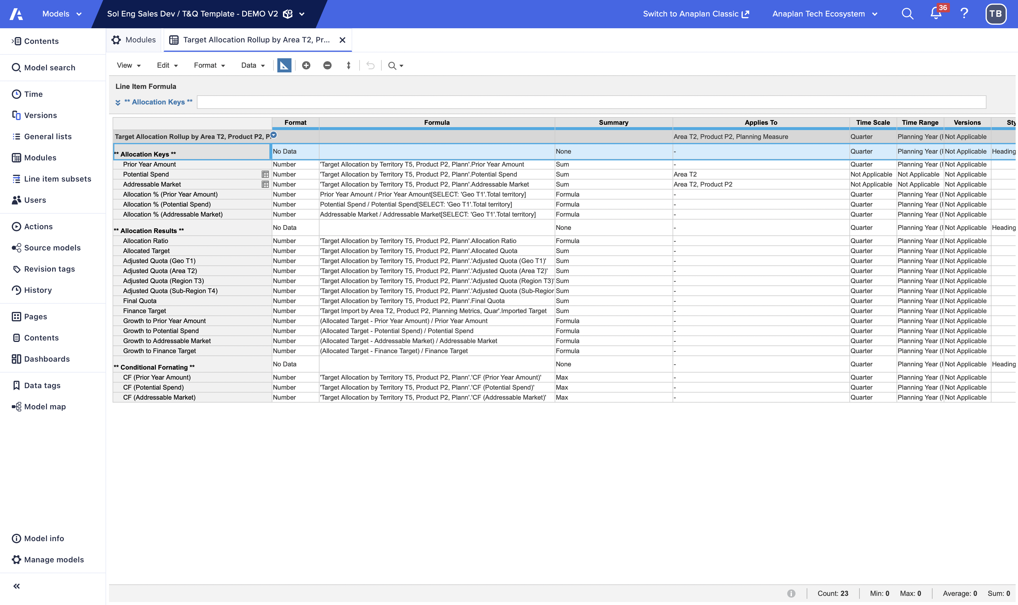
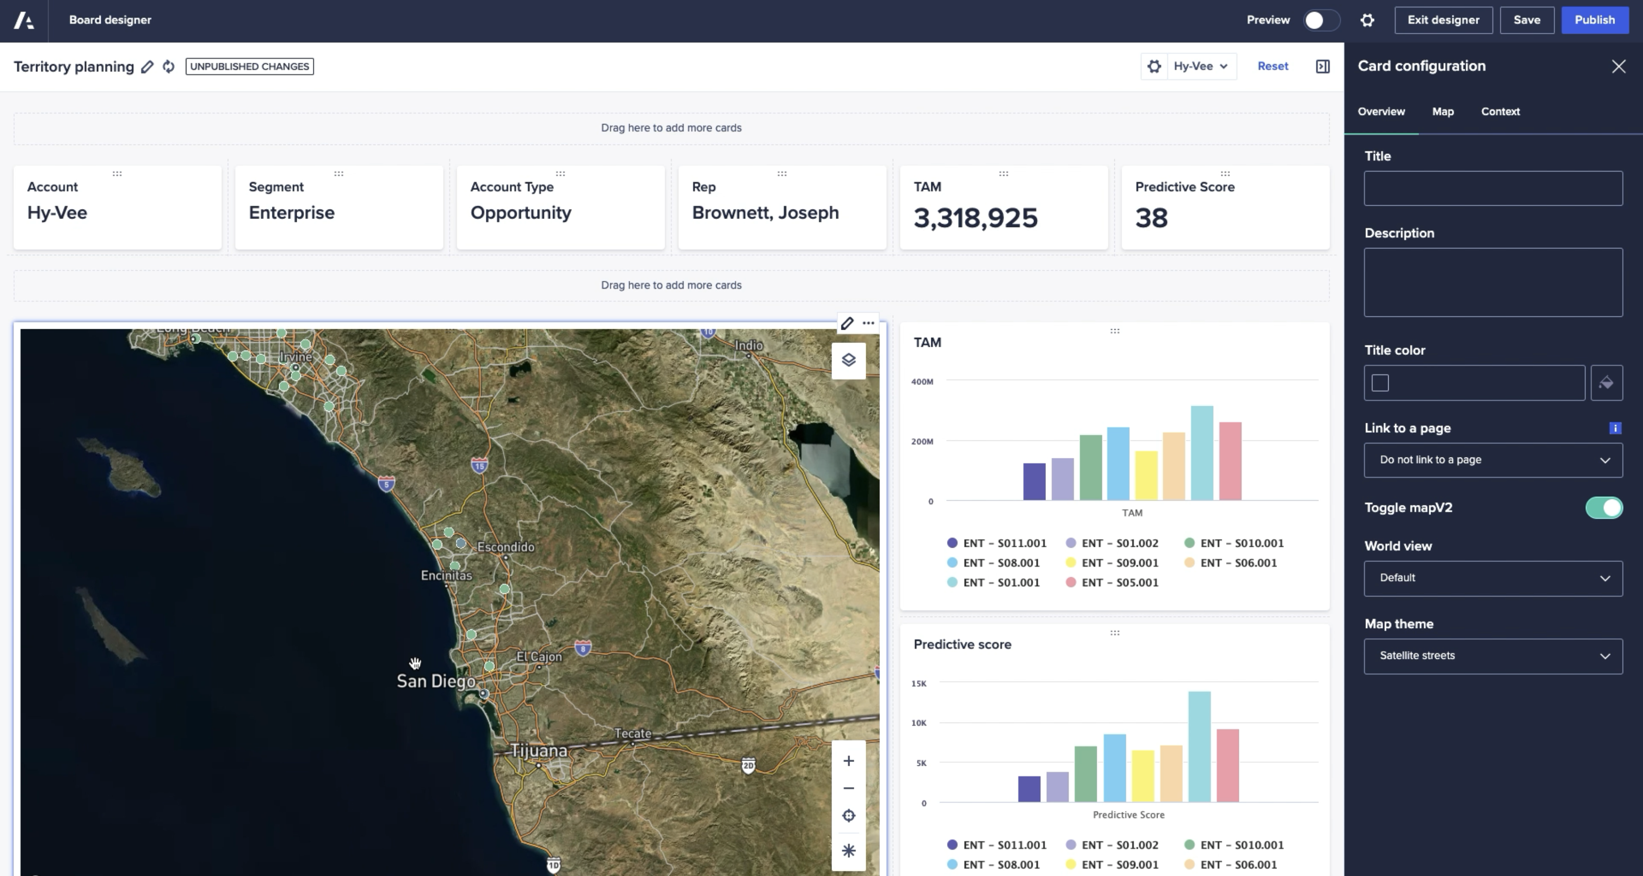
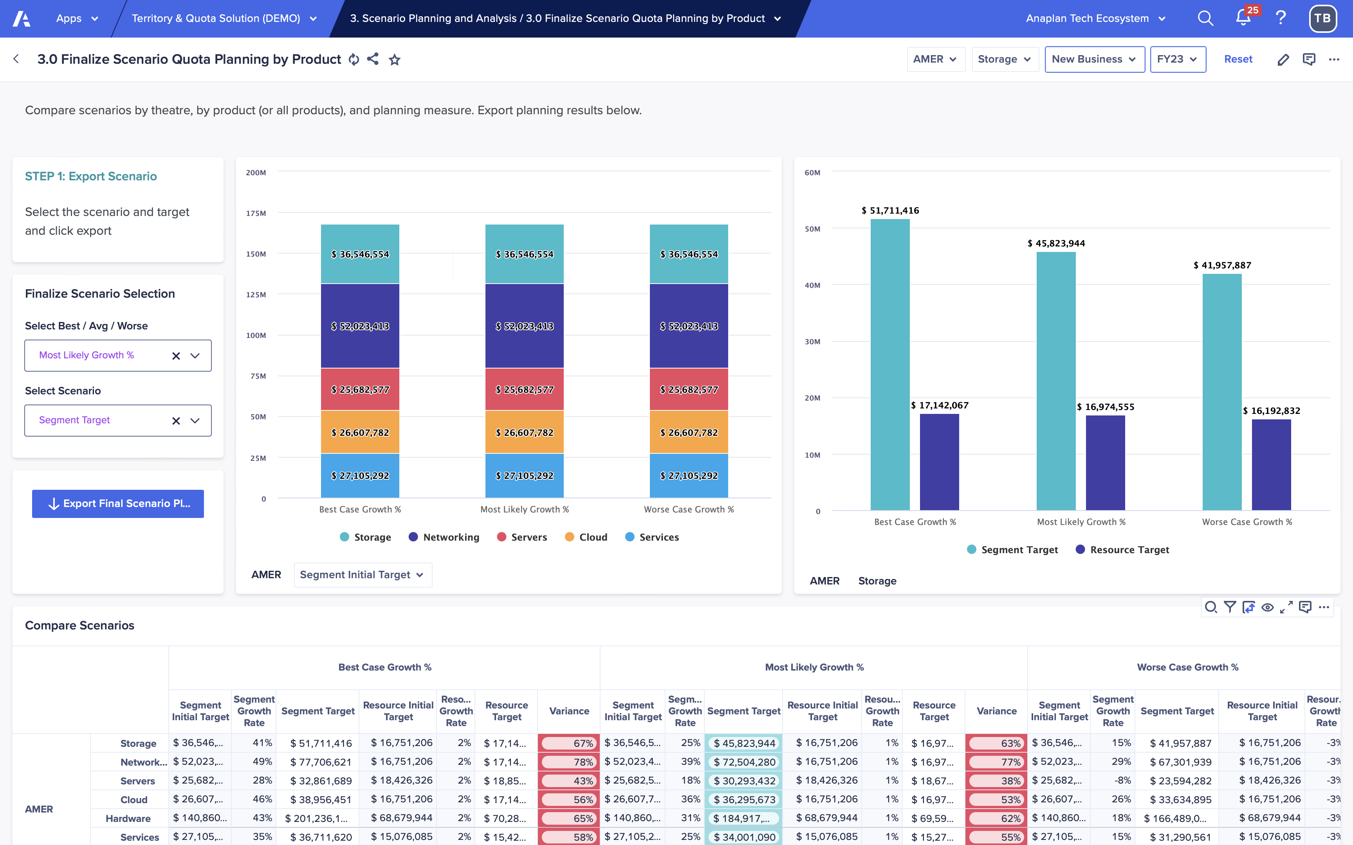
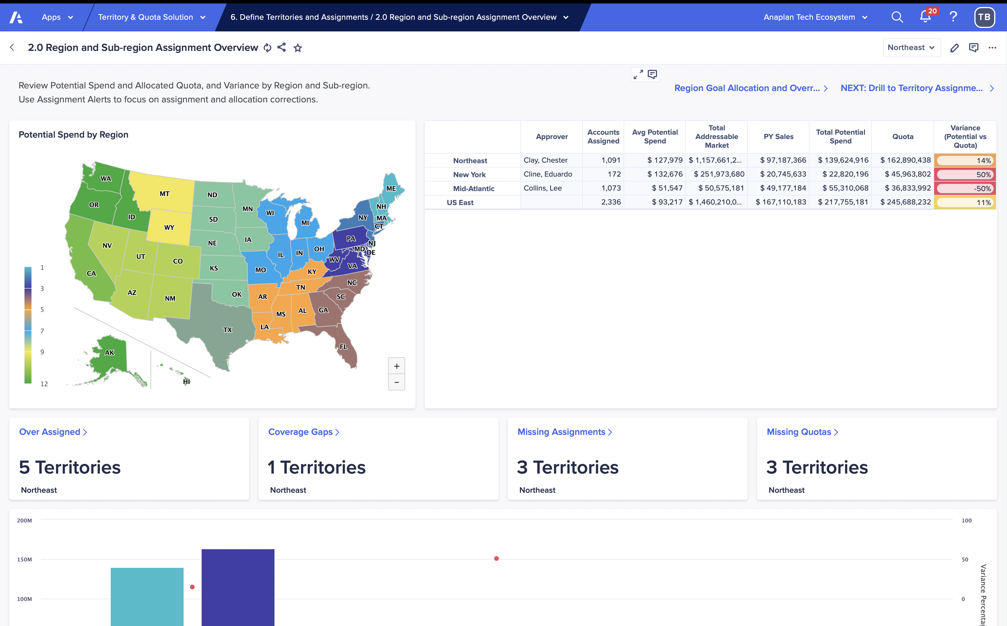
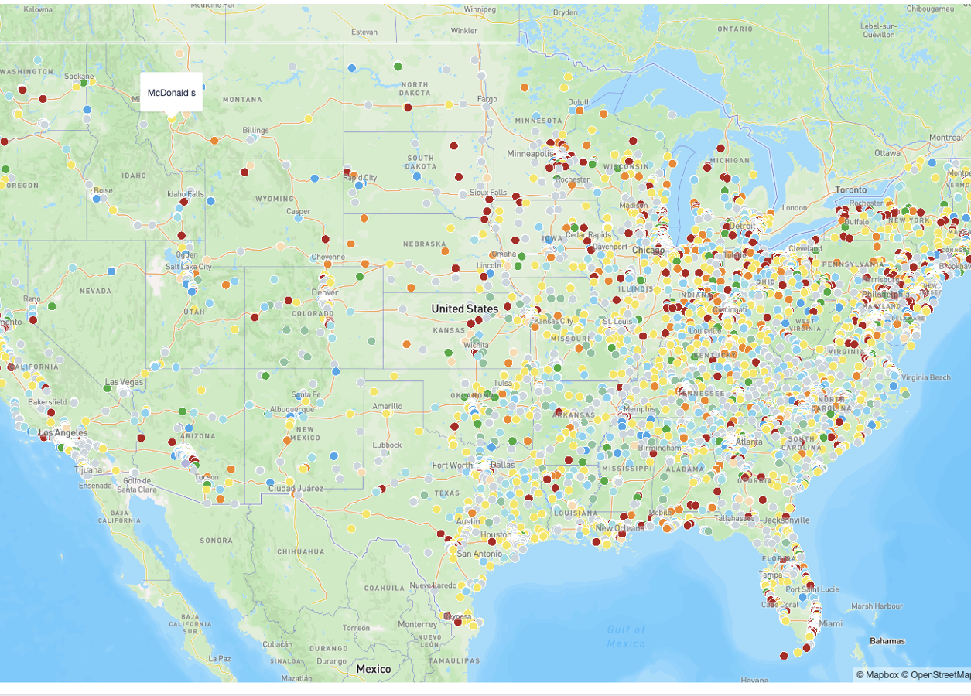
Anaplan Go-to-Market Planning
Application Implementations
3-step implementation: Configure. Extend. Deploy.
Start with a guided setup that builds your model and UX automatically, based on structured inputs about your hierarchies, data, naming conventions, and GTM logic. Your planning foundation is purpose-built from day one.
Configure
Extend
Adapt and expand the application to reflect your business’s unique needs. Leverage the power of Anaplan’s flexible modeling platform to make the
app your own, without starting from scratch.
Deploy
Move quickly into testing and rollout. This accelerated path to deployment helps you capture value sooner, with built-in best practices and a launchpad for future expansion across your business, ready to evolve alongside your business with additional Anaplan applications or purpose-built extensions.

Slide 8
Process and configurable elements
Section 2

Slide 9
Territory and Quota Planning framework
Step 0
Step 1
Step 2
Step 3a
Step 4
Score the market
(import)
Create or refine the sales hierarchy
(Org Design)
Create or refine sales roles
Segment accounts
(set potential account values)
Top-down target planning
STRUCTURAL DESIGN
Step 3b
Step 5
Step 6
Step 7
Step 8
Set organizational targets
Allocate territory targets
Assign reps to territories
(Set Quota)
Roll up overlay reps and management
(Set Quota)
Territory & Quota management
ALLOCATION
Bottom-up scenario planning
Segmentation & Scoring
Sales Forecasting
Compensation Design
Capacity Planning
Incentive Compensation Management
ADJACENT PROCESSES
Notes:
Bottom-up scenario planning

Slide 10
Territory and Quota Planning: Key processes and configurable elements​
Step | Process Name | Process Description | Configurability
0 | Account Value | Review historical sales data. Load addressable Market. Review Account level data and determine and set account value using selected methods. | Select dimensionality and metrics to report on historical sales data. Select dimensionality to load addressable market. Select metrics used to calculate account value.
3b | Scenario Planning | Create full year data set combining actuals and forecast for remainder of year. Generate two scenario plans: Account Attribute Plan Resource Plan based on Avg Quota Compare plans and make final selection. | Select data source for actuals and forecast. Select territory hierarchy level and additional dimensionality used for scenario planning. Create scenarios through Optimizer or manually. Add and configure planning measure KPIs.
3b,5 | Goal/Target Setting | Load initial target. Top-down allocation of the target throughout the territory hierarchy. Input overallocation percentages and overrides throughout territory hierarchy. Bottom-up allocation of the targets from the account level. | Select territory hierarchy level and additional dimensionality to load initial target. Add and configure allocation metrics. Select territory hierarchy levels to input overallocations and overrides. Select account attributes to view while allocating quota to account.
3a,5 | Target Approval Process | Review summary of assigned targets based on territory level. Approve or reject and send notifications either up or down the hierarchy based on the level. Lock target once finalized. | Select levels of the territory hierarchy to set approvals on.
6,7 | Resource Alignment | Simple direct assignment of employees to role and territory level for high level assignments. Assignment of reps to territory level. Assignment of overlay reps to upper territory level. Creation and assignment of TBH reps. | Select levels for high level assignment. Select territory level for rep and overlay assignment. Select employee attributes to view while processing assignments.
4 | Manage Territory Hierarchy | Ability to update and change the territory hierarchy for all levels. Add or remove items in the hierarchy. | Select and name levels of the territory hierarchy.
3a,4 | Account Alignment | Reporting on assignments, PV and potential spend over various levels of territory hierarchy. Assignment of accounts to territory level. Manage account hierarchy (parent and child accounts). | Select levels of the territory hierarchy for geospatial mapping. Select territory level for account assignment. Select account attributes to view while processing assignments.

Slide 11
Territory and Quota Planning: Key processes and configurable elements​ - cont.
Step | Process Name | Process Description | Configurability
1, 7 | Global Account Management (GAM) | Identify global parent accounts that are part of GAM program. Create GAM Hierarchy. Identify GAM Reps. Input GAM Targets and allocate top-down. Update GAM rep assignment matrix (GAM, Theatre Leads and Country GAM’s). Create Territories, Rep to territory assignments and account to territory assignments. Calculate quotas. | Select level of territory hierarchy to link to country.
1, 7 | Named Account Management | Identify named parent accounts. Input global targets for named accounts. Identify Named Account Executive (NAE) and Supporting Named Account Executive (SNAE). Assign accounts to NAE and SNAE territories. Override quotas by account and calculate quotas.
2,6,7 | Quota Setting | Define quota types for each sales role by identifying the measures used to calculate the quota. Calculate quota at each level of the territory hierarchy where reps are assigned based on the quota types. Compare total front line rep quota to target. Export view of final quota by resource. | Select time period for quota calculation. Select measures used to calculate the quota.
4 | Assignment Rules | Set priority of account attributes for evaluating rules. Add and modify criteria to set which accounts are eligible to be processed by rules. Create rules by territory to set which accounts should be assigned to the territory. Manage and act on accounts with conflicts between rules. | Select account attributes for rule eligibility. Select account attributes for matching criteria.

Slide 12
Prework and assumptions
Section 3

Slide 13
Assumptions
To successfully implement this application as designed, the planning process must meet the following assumptions.
Assumptions:
Your planning process includes only a single direct plus overlay hierarchy.
You must have an existing territory hierarchy.
You should not have more than 5 planning measures (e.g., New Business or Expansions).
You should not set quotas for more than 10 products.
Assignment rules x # of accounts should not exceed 1.5B
If these are not true today, there are two options:
Modify or extend the application to accommodate the existing planning model.
Adjust the planning process to align with supported methodologies and industry best practices.

Slide 14
Sales Data Requirements and Description
Data | Description | Mandatory Attributes​
Actuals (such as orders, bookings, invoices, transactions, etc.) | This can be either one data file or can be loaded with two data files where the second is a more detailed line-item level (i.e., Orders and order lines where the order lines contain details by products). | ID, name, account, planning measure, product, date, amount If using the detailed data file, have an ID to link to the initial file The mandatory attributes must be present between the two data files
Forecast (ie. Opportunities) | This can be either one data file or can be loaded with two data files where the second is a more detailed line-item level (i.e., Opportunities and opportunity lines where the lines contain details by products). | ID, name, account, planning measure, product, date, amount, attribute to filter likely deals (such as forecast category or deal stage) If using the detailed data file, have an ID to link to the initial file The mandatory attributes must be present between the two data files
CSV files should be a flat view with the attribute fields in columns and items in rows
The files can include additional attribute fields
Can bring additional data files in as needed
All files should have a column for "Date Loaded to Anaplan" which should be populated by current date

Slide 15
Metadata requirements and description
Dimensions | Description | Mandatory attributes
Accounts (could also be clients, customers, etc.) |  | Name, ID, Parent, Territory, Address (city, state, country, postal code), account owner
Product (could also be offerings, services, etc.) |  | Name, ID, Parent
Employee (could also be sales reps, sellers, etc.) |  | Name, ID, territory, Manager, email, Role, Role start date
Territory |  | Name, ID, Parent, Territory manager
Geography |  | Name, ID, Parent
Sales Role (Seller type) |  | Name, ID
CSV files should be a flat view with the attribute fields in columns and dimension items in rows.
The files can include additional attribute fields.
They can bring additional dimensions and hierarchies in as needed.
Where numbered lists are referenced (e.g. DH Attributes by Account Flat.Account Parent), the value loaded to that field in the data hub should be the code, not the name (e.g., 1234 rather than Procter and Gamble).
For files that contain hierarchies, these must be in parent child format. There is no need to include a parent for the first level of the hierarchy.

Slide 16
Model design
Section 4

Slide 17
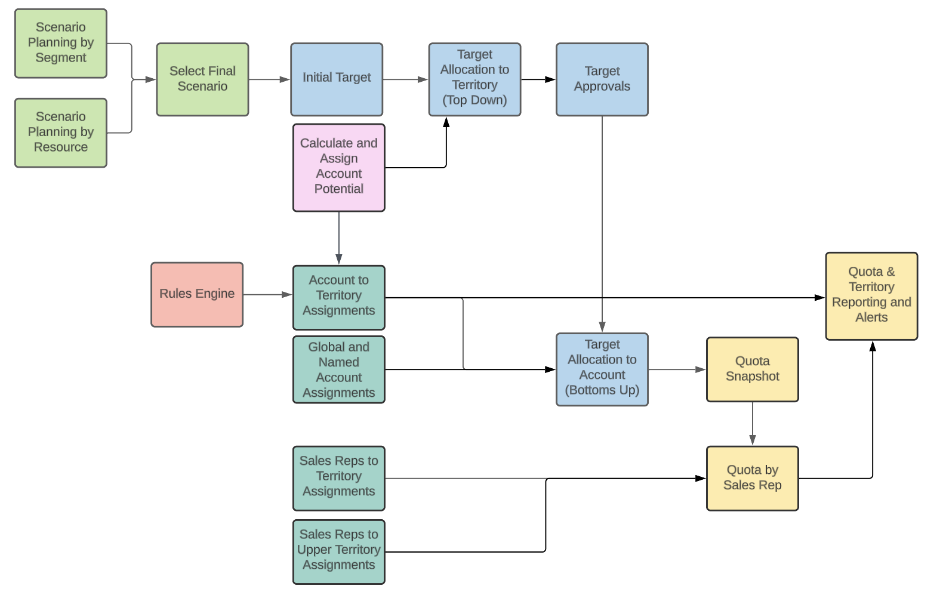
Model diagram overview​

Slide 18
Historical data, addressable market, and potential account value
Overview
Allows businesses to leverage account data to calculate value and segment accounts for deeper planning and targeting. The guided setup enables configuration of account attributes and calculations. The dashboards provide analysis of accounts across different attributes and dimensions.
Import account data and addressable market
Bring in book of business from source system.
Include attributes identified in setup process such as industry, size, location, sales history.
Set up additional account fields to use like predictive scores, segments.
Provide reporting on selected dimensions such as industry, segment, product, and time and selected KPIs such as PY Sales, CY Sales, YoY Growth, # of Accounts, Average Sales.
Import addressable Market by selected dimensionality.
Calculate account value
Set up and use multiple different methods to estimate account value. This includes methods such as:
  Industry Average: Average prior year sales value by industry.
  Predictive Spend Average: Average prior year sales by predictive account rank (A, B, C, etc).
  Selection of one average value on which to include a lift factor.
  Growth %: Apply growth rate to prior year sales.
  Manual override of calculated account values on individual basis.

Slide 19
Historical data, addressable market, and potential account value
Key modules
Generic module name | Description | Guided setup inputs / explanation
Hist Metrics | Provides reporting on historical data to include things like PY sales, CY sales, number of accounts, average PY sales, YoY growth %. | Module will get replicated by selected attributes in guided setup and will include line items input in guided setup
INPUT: Account Lift by Account Attribute | Input module for the lift factor to be applied to account attribute used to calculate potential account value.
INPUT: Account Value | Input module for default growth factor and for choosing default method to calculate potential spend.
Addressable Market | Input module to load addressable market. | Dimensionality selected in configurator
Potential Account Value by Account | Calculates potential spend for each account. Uses the methods defined in the | Set up methods for calculating potential growth Select account attributes that will be displayed

Slide 20
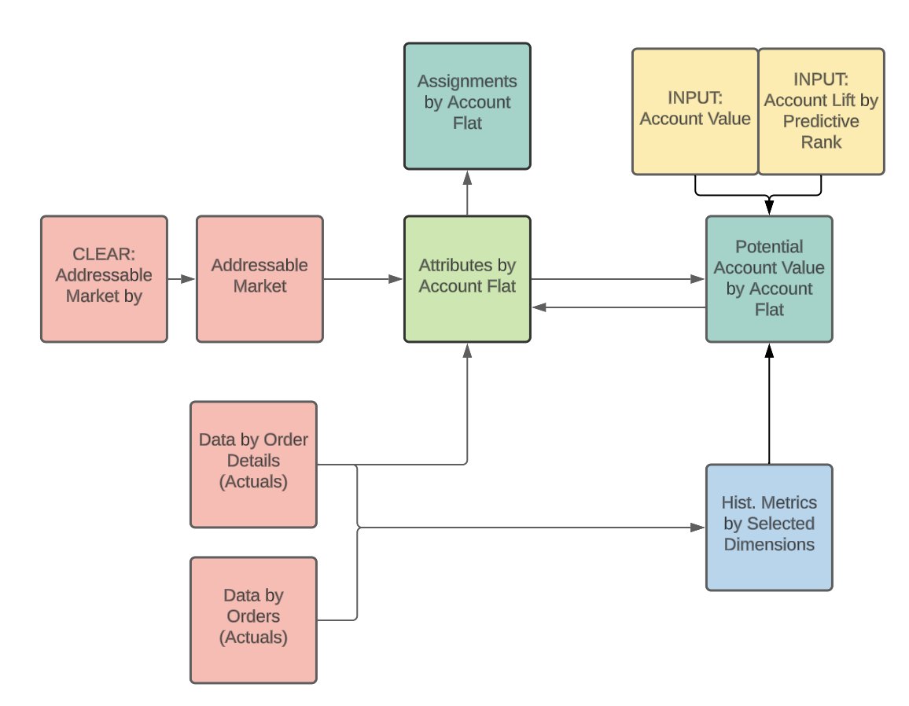
Historical data, addressable market, and potential account value
Diagram

Slide 21
Scenario planning
Overview
Allows businesses to leverage actuals and forecasts to model different potential sales scenarios and finalize the most likely plan to use for territory, quota, and resource planning. The guided setup screens allow configuration of dimensions to match the business needs.
Create Full Current Year Forecast
Import historical and forecast sales order data from source system.
Bring in amount, products, dates, and other attributes.
Set filters to only include high probability opportunities.
Apply filters to find extremely high or low sales orders and opportunities that could skew results and allow users to input manual overrides for outliers to bring them closer to average.
Combine actual and forecast sales to project full year sales.
Create two Scenario Plans by Account Attribute and by Resource
For both plans, define alternate scenarios like best case, most likely, worst case and apply growth assumptions to estimate next year's target.
Scenario plan by account attribute is set up by selected territory level, selected account attribute and additional dimensions. Apply growth rates on top of full year forecast to create next year target.
Scenario plan by resource is set up by selected territory level, front line rep sales roles, and additional dimensions. The plan calculates an average quota number and then applies growth rates to the number of reps to come up with next years target.
Analyze and Compare Scenarios
Review and compare results of different scenarios side-by-side.
Assess growth rates and variances to select final scenario plan.
Export selected scenario to use for downstream planning.
Push down scenario plan to replicate the level targets will be imported at.

Slide 22
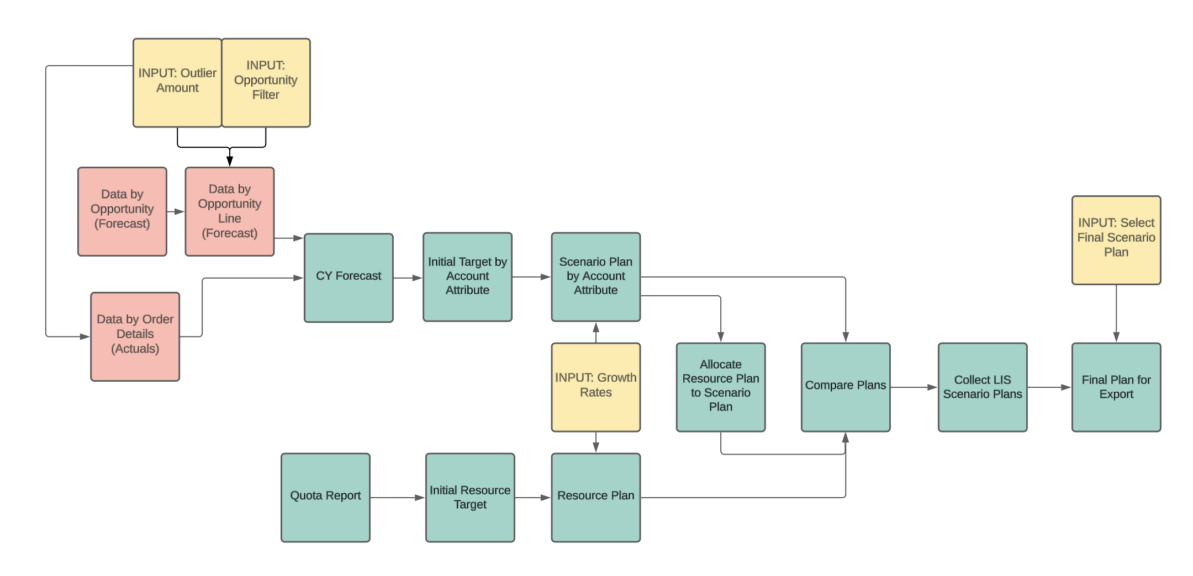
Scenario planning
Diagram

Slide 23
Sales Territories Optimizer
Overview
Goal: Assign accounts to territories to minimize imbalance (deviation from targets) while honoring business constraints (capacity, segment mix, geography).
Inputs: Accounts, Territories, hierarchy (Area → Region → Sub‑Region), target/weights.
Assignments: Proposed links of Account → Territory.
Constraints: One‑account‑one‑territory, min/max accounts per territory, segment mix bounds.
Calculations: Deviations and adjusted averages at Area/Region/Sub‑Region, run‑specific targets (Run 1/Run 2).
Optimization: Balancing equations aggregate penalties; optimizer searches for feasible, low‑deviation assignments.
Outputs: Final assignments, counts per territory, KPI deltas vs targets.
Accounts + Territories → Constraints → Calculations → Optimization → Outputs

Slide 24
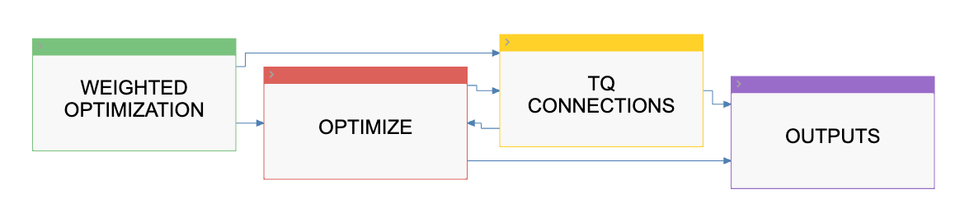
Sales Territories Optimizer
High Level Diagram

Slide 25
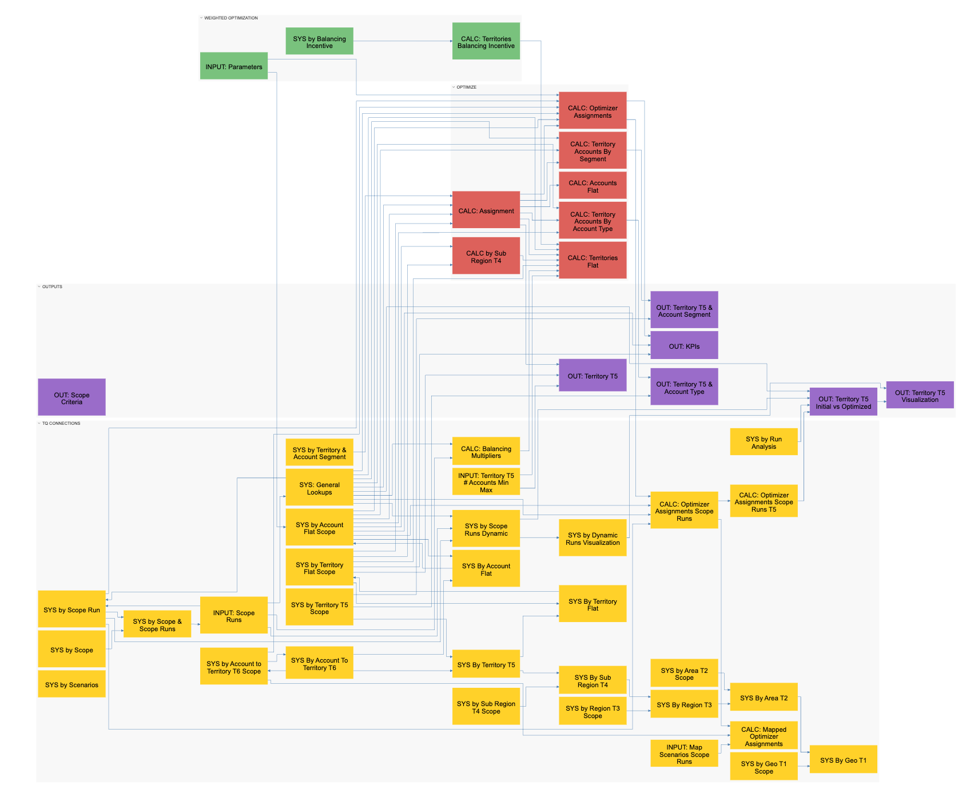
Sales Territories Optimizer
Detailed Diagram
Note: Please zoom to see the detailed Optimizer Model Map

Slide 26
Target setting and approvals
Overview
Allows businesses to bring in top-down goals, allocate them to operational units, review and approve at each level, and finalize targets. The guided setup provides configuration of import dimensions, allocation methods, and approval workflow.
Top-down target setting
Load top-down targets from finance/executive team by selected territory hierarchy level, planning measure, and additional dimensions.
Set up multiple methods to allocate targets down the territory hierarchy (i.e., sales history, potential spend, addressable market).
Apply overallocations to boost targets.
Allow manual overrides at certain levels.
Review and approve targets
Walk through each hierarchy level for approvals.
Provide comments, set approval status.
Send notifications to next level approver.
Bottom-up quota setting
Allocate territory targets down to child accounts using selected methods (ie. sales history, potential spend, addressable market).
Allow account specific holds and overrides.
Allow territory specific overrides.
Finalize quota
Compare top-down versus bottom-up targets.
Identify variances and drivers of differences.

Slide 27
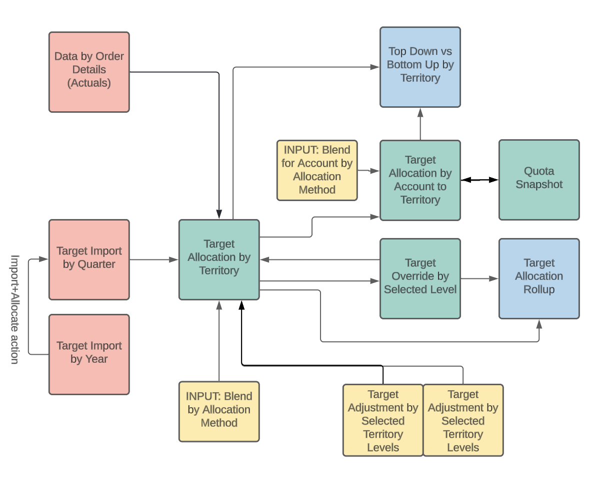
Target setting and approvals
Diagram

Slide 28
Resource alignment
Overview
Allows businesses to manage resource assignments across the territory hierarchy over time. This enables organizations to align territories, accounts and resources within one planning model. The guided setup provides configuration of selected levels for assignments.
Manage sales reps
Import sales reps and attributes like role, level, location from HR system.
Manage resource roster, view all reps with attributes and status.
Add new TBH reps for planning.
Change sales rep roles and start dates for scenario planning.
Review and update assignment of resources to hierarchy
Simple one-to-one overlay and management rep assignment for specific roles to top levels of the territory hierarchy.
For territory level and one higher level, assign reps based on roles.
Set effective dates to track changes over quarters/months.
View coverage gaps or overlaps in assignments.
Reassign or remove reps from territories as needed.
Report on active reps by territory over time.
Supports territory assignment changes each month/quarter.

Slide 29
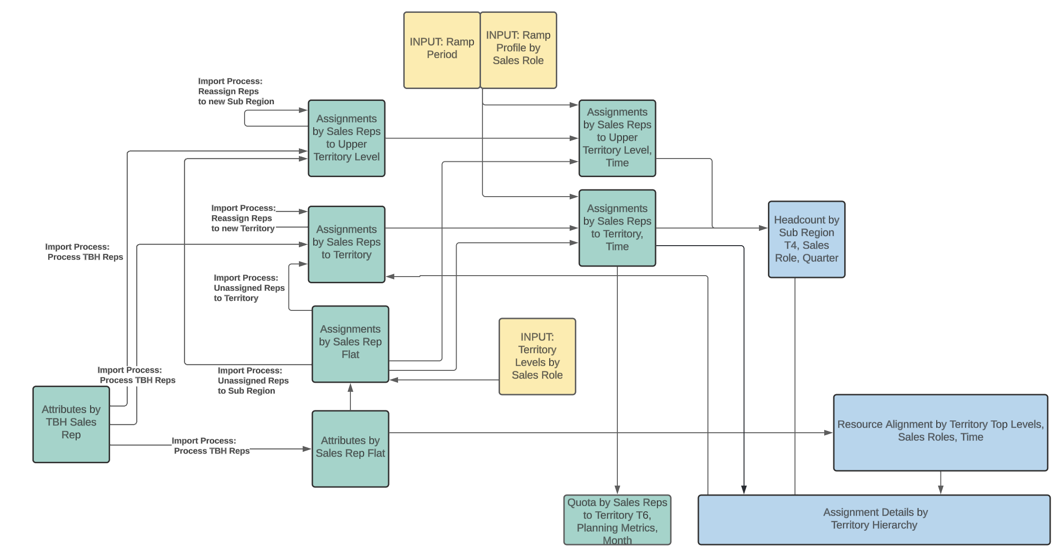
Resource alignment
Diagram

Slide 30
Manage territory hierarchy and assign accounts to territory
Overview
The hierarchy setup provides a framework to model territories. The assignment dashboards allow users to align accounts to territories manually or with rules. The reporting and map views enable analysis of gaps and overlaps in coverage. This gives organizations visibility into account assignment and flexibility to optimize over time.
Build Territory Hierarchy
Configure hierarchy levels like region, area, territory.
Add, edit, move, or remove items in each level.
Maintain parent-child relationships between levels.
Assign and Analyze Accounts to Territories
Match individual accounts to specific territories by manually assigning accounts or using rules to automate.
Set assignment start dates for tracking over time.
Identify unassigned accounts needing alignment.
Change account to territory assignments as needed.
Analyze assignments across hierarchy for gaps or overlaps.
Filter and view assignments at any hierarchy level or across specific segments or industries.
Visualize assignments on regional map view, select accounts on map to reassign territories.
Manage Account Hierarchy
Build parent-child relationships between accounts.
View and edit child accounts under each parent.
Option to create dummy parents to group accounts.
Map account assignments.

Slide 31
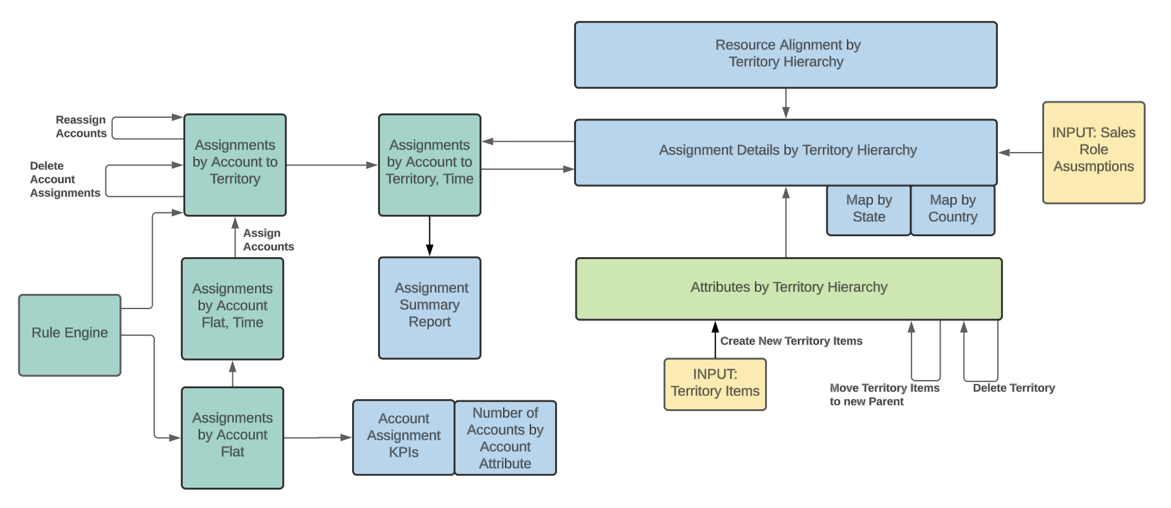
Manage territory hierarchy and assign accounts to territory
Diagram

Slide 32
Manage rules for account assignment
Overview
Allows business to efficiently align accounts to territories as the business evolves. The model allows easy setup of rules leveraging existing account attributes. The rule engine automates standardized assignment of accounts to territories. Dashboards provide visibility into results for managing conflicts and validating assignments.
Configure Rule Settings and Define Eligibility Criteria
Select account attributes to use for eligibility and matching.
Set priority order for applying multiple rules.
Set filters on attributes like segment, industry, size to define eligible accounts.
Review and adjust criteria to include desired accounts.
Create Assignment Rules and Manage Conflicts
Build rules for each territory using selected attributes such as segment, geography, zip code.
Rules will assign accounts meeting criteria to specified territories.
Identify conflicts where rules assign same accounts to different territories.
Adjust rules to resolve conflicts before running.
Execute Rules and Review Assignments
Select rules to run to automate account assignments.
Set effective date for batch assignment of accounts.
Analyze results to validate accounts assigned as expected.
Filter accounts assigned by each rule for audit trail.

Slide 33
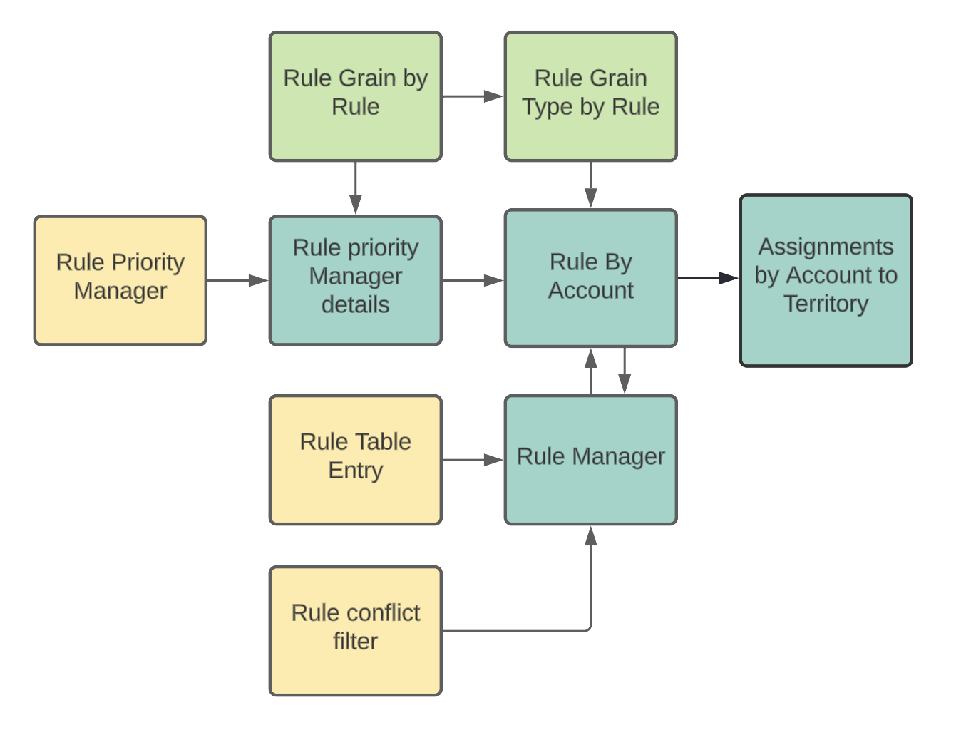
Manage rules for account assignment
Diagram

Slide 34
Quota Setting
Overview
The setup allows configuration of quota types, products, and ramps. The dashboards provide visibility into quota details and variances. Approval workflows ensure quotas are validated. This gives sales leaders a centralized model to set, analyze and approve quotas aligned to targets and resources.
Configure Quota Settings
Define quota types by role, like total revenue, new business.
Set hierarchy levels for quota assignment by role.
Select products to include in quota calculations.
Allocate Quotas to Reps
Use territory targets to assign quota amounts to each rep.
Quotas align to where reps are assigned in hierarchy.
Supports multiple quota types for overlay reps.
Input ramp rates to gradually increase quotas.
Accommodates reps starting mid-year with partial period ramps.
Enable manual adjustments to allocated quotas as needed (typically used for exception situations).
Report and Approve Quotas
Analyze variances between top-down targets and bottom-up quotas.
Compare quotas across hierarchy levels and quarters.
Walk through quota approval process by territory/region.
Lock approved quotas to prevent further changes.

Slide 35
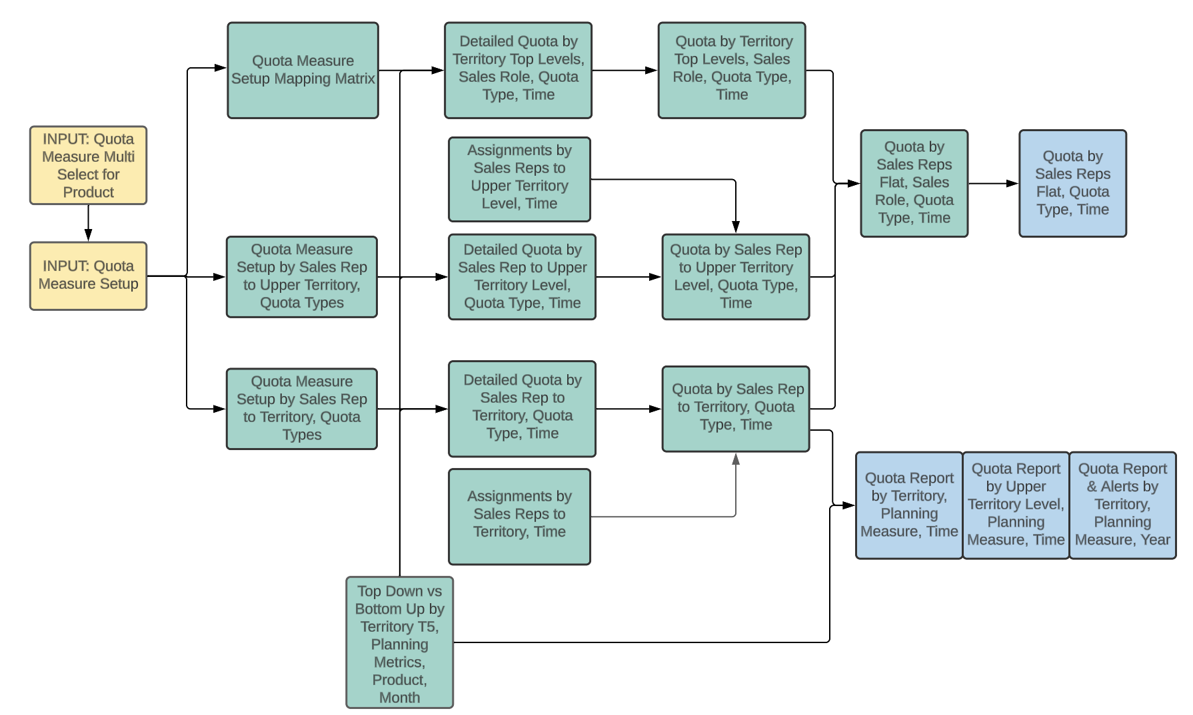
Quota Setting
Diagram

Slide 36
Strategic Account Management
Overview
Strategic accounts are accounts that have global presence. Strategic accounts are owned by Strategic account managers and Strategic account executives.
Select Strategic Accounts and create Territory Hierarchy
Adds the selected accounts to strategic accounts program.
Creates the territory hierarchy for strategic accounts with the following branches:
  Strategic Account Manager Hierarchy.
  Strategic Account Executive for Regions Hierarchy.
  Strategic Account Executive for Sub Region/Countries Hierarchy.
Identify Strategic Reps
Strategic reps only own strategic accounts and will not be assigned any non-strategic accounts.
Target Setting
Input finance targets for the strategic accounts program at the geo level.
Over assignment or target overrides are applied on the finance targets to set the target for the strategic accounts program by geo.
Strategic account target at geo level is pushed down to account level by geo and account and sub region level based on the PY sales for each of the strategic accounts.
Rep Assignments
Strategic account manager, Strategic account executive for regions and strategic account executive for sub region/Countries are updated.
Territories are created based on the rep assignment matrix.
Create territories, rep assignments, and account to territory assignments for strategic accounts.
Quota calculation
Strategic account manager quota: Aggregate of the target associated with the parent accounts the rep is assigned to.
Strategic account executive for regions: Aggregate of the target associated with the child accounts under the region based on the strategic account rep assignment matrix.
Strategic account executive for sub region/countries: Aggregate of the target associated with the child accounts under the sub region based on the strategic account rep assignment matrix.

Slide 37
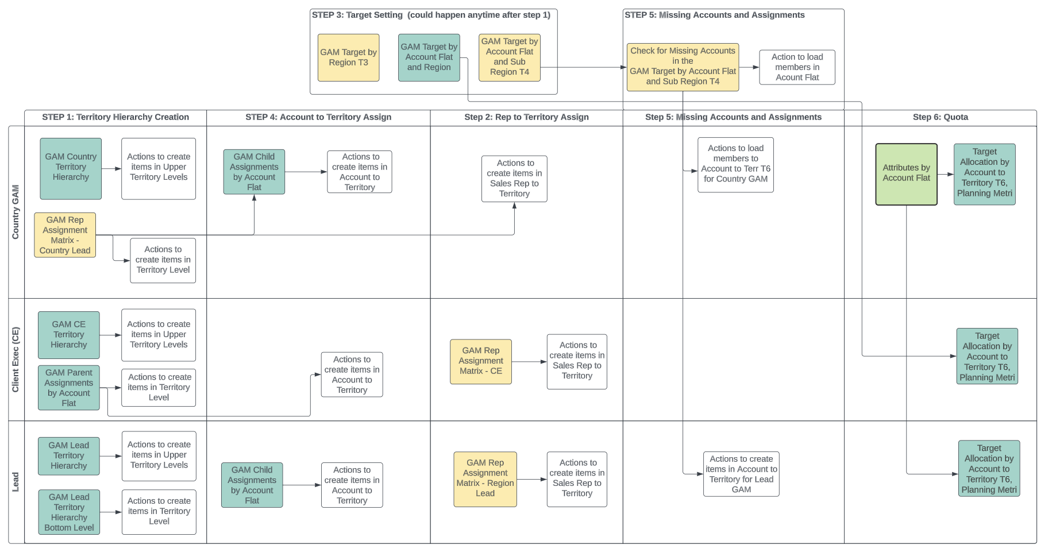
Strategic Account Management
Diagram

Slide 38
Named Account Management overview
Named accounts also have global presence like strategic accounts. They are owned by named account executives (NAE), supporting named account executives (SNAE) and reps
Identify accounts that will be part of named accounts program for the coming planning year
Adds the selected accounts to named accounts program.
Identify Strategic Reps: NAE's and SNAE's are assigned to the territories in the main hierarchy and own field accounts along with the named parent account.
Identify the NAE and SNAE for the named accounts.
Assign the named parent accounts to both NAE and SNAE territories.
Assignments for the named child accounts come from salesforce.
Target Setting
Input the targets for the named accounts based on the PY sales and the pipeline of the named accounts.
Quota Calculations
View the quota based on the parent named accounts assigned to the NAE and SNAE territories and the rollup of the quota from the child named accounts.
Adjust the quota of the accounts to match the quota to the target set for the named parent account.

Slide 39
For more information, refer to applications.anaplan.com

